Slide 1

AutoConnect
"Driving Your Dreams, One Click at a Time"

Slide 2
Project Supervisor: Mr. Ubaid Aftab Chawala
Group Members
Ishaqullah Siddiqui (20k-0148)
Muhib Ahmed (20k-0405)
Sarim Latif Khan (20k-1644)

Slide 3
Problem Statement
- Complex Car Transactions:
- Choosing the right vehicle
- Negotiating prices
- Assessing vehicle history
- Information Overload:
- Abundance of online car information
- Difficulty in making informed decisions
- Trust Concerns:
- Doubts about trustworthiness of buyers and sellers

Slide 4
Solution Overview
"Introducing AutoConnect: Transforming the Way You Buy and Sell Vehicles"
- Simplified Decision-Making:
- Intuitive interface
- Streamlines car transactions
- Simplifies choices for users
- Data Intelligence:
- Aggregates and analyzes data
- Provides accurate information
- Includes vehicle history reports and market trends
- Negotiation Assistance:
- Chatbot support
- Offers insights and suggestions
- Helps with fair and beneficial deals
- Trust & Transparency:
- User-generated reviews and ratings
- Enhances trust
- Real-time messaging for transparent communication
- Personalized Recommendations:
- AI recommendation engine
- Suggests vehicles based on user preferences
- Streamlines the search process

Slide 5
Literature Review
- Online Car Marketplaces:
- Essential in the automotive industry, facilitating digital transactions.
- Leading Platforms:
- PakWheels and CarFirst: Known for extensive listings and user-friendly interfaces.
- Current Limitations:
- Limited negotiation tools
- Basic communication tools
- Room for Innovation:
- Opportunity to enhance user experience
- Enhance Buyer, Seller communication
- Fueling Negotiations with Smart Middleware

Slide 6
Comparative Analysis
Features | PakWheels | CarFirst | Gaari.pk | AutoConnect
Vehicle Listings | ✓ | ✓ | ✓ | ✓
Selling/Buying Cars | ✓ | ✓ | ✓ | ✓
Vehicle Comparison | ✓ | ✕ | ✓ | ✓
AI Driven Recommendations | ✓ | ✕ | ✕ | ✓
User Reviews | ✓ | ✓ | ✓ | ✓
Customer Support | ✓ | ✓ | ✓ | ✓
Advanced Search Filters | ✓ | ✓ | ✓ | ✓
Live Video Calling | ✕ | ✕ | ✕ | ✓
Smart Negotiation chatbot | ✕ | ✕ | ✕ | ✓

Slide 7
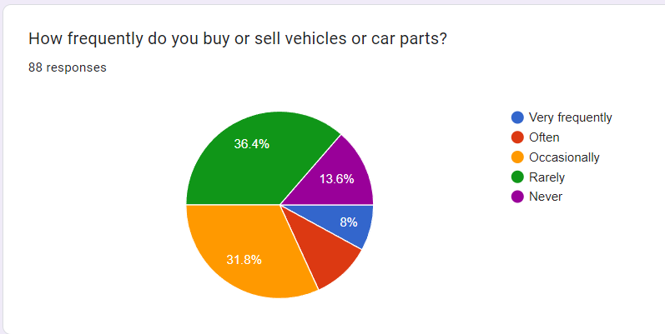
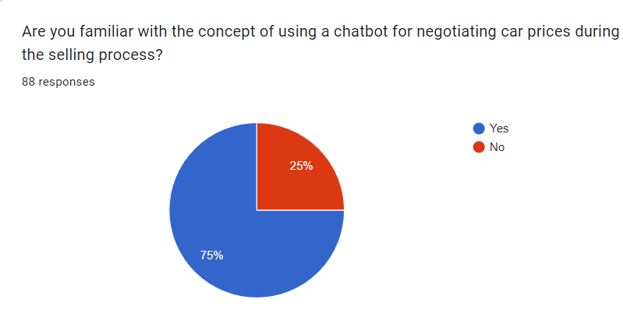
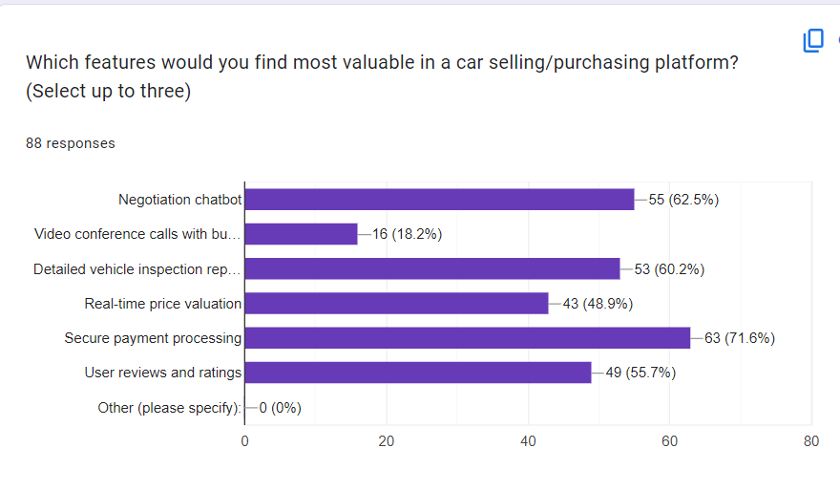
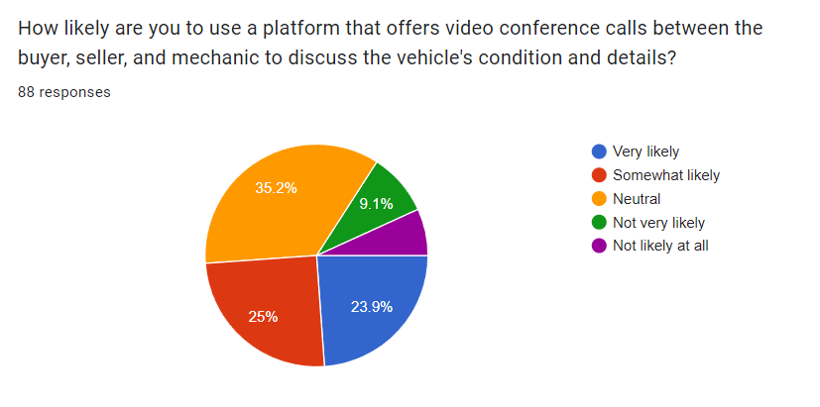
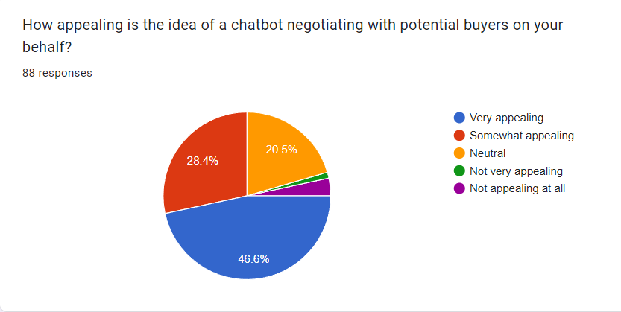
Market Survey

Slide 8
Key Features
1. Smart Negotiation Bot: Say goodbye to haggling. Our bot ensures fair deals.
2. Live Video Calling: Expert-guided vehicle inspections in real-time.
3. Comprehensive Listings: A wide variety of vehicles for every preference.
4. Personalized User Accounts: Tailor your journey.
5. Diverse Portals: Connecting users, mechanics, and enthusiasts.
6. Effortless Vehicle Comparison: Make informed decisions effortlessly.
7. Advanced Search and Filters: Find the exact vehicle you desire.
8. Empowering User Reviews: Contribute to an informed community.
9. Real-time Communication: Swift and effective interactions.
10. Insightful Vehicle History: Transparency through trusted APIs.
11. Expert Customer Support: Instant resolution for a smooth experience.
12. AI-Driven Recommendations: Your personalized vehicle suggestions.

Slide 9
Negotiation ChatBot In Automotive E-Commerce
Chatbots in e-commerce are valued for enhancing customer interactions. While they've been used in online car sales for inquiries, our project aims to introduce a negotiation chatbot for smoother transactions, filling a gap in this area. This chatbot will actively engage with buyers, negotiate for sellers, and improve the overall car buying experience. Negotiating chatbots represent an exciting frontier in artificial intelligence and natural language processing. These intelligent agents are designed to engage in conversations, deliberations, and bargaining with users or other bots, simulating the negotiation processes observed in human interactions. They have the potential to streamline various negotiation scenarios, from e-commerce transactions to dispute resolutions, offering efficiency and convenience.

Slide 10
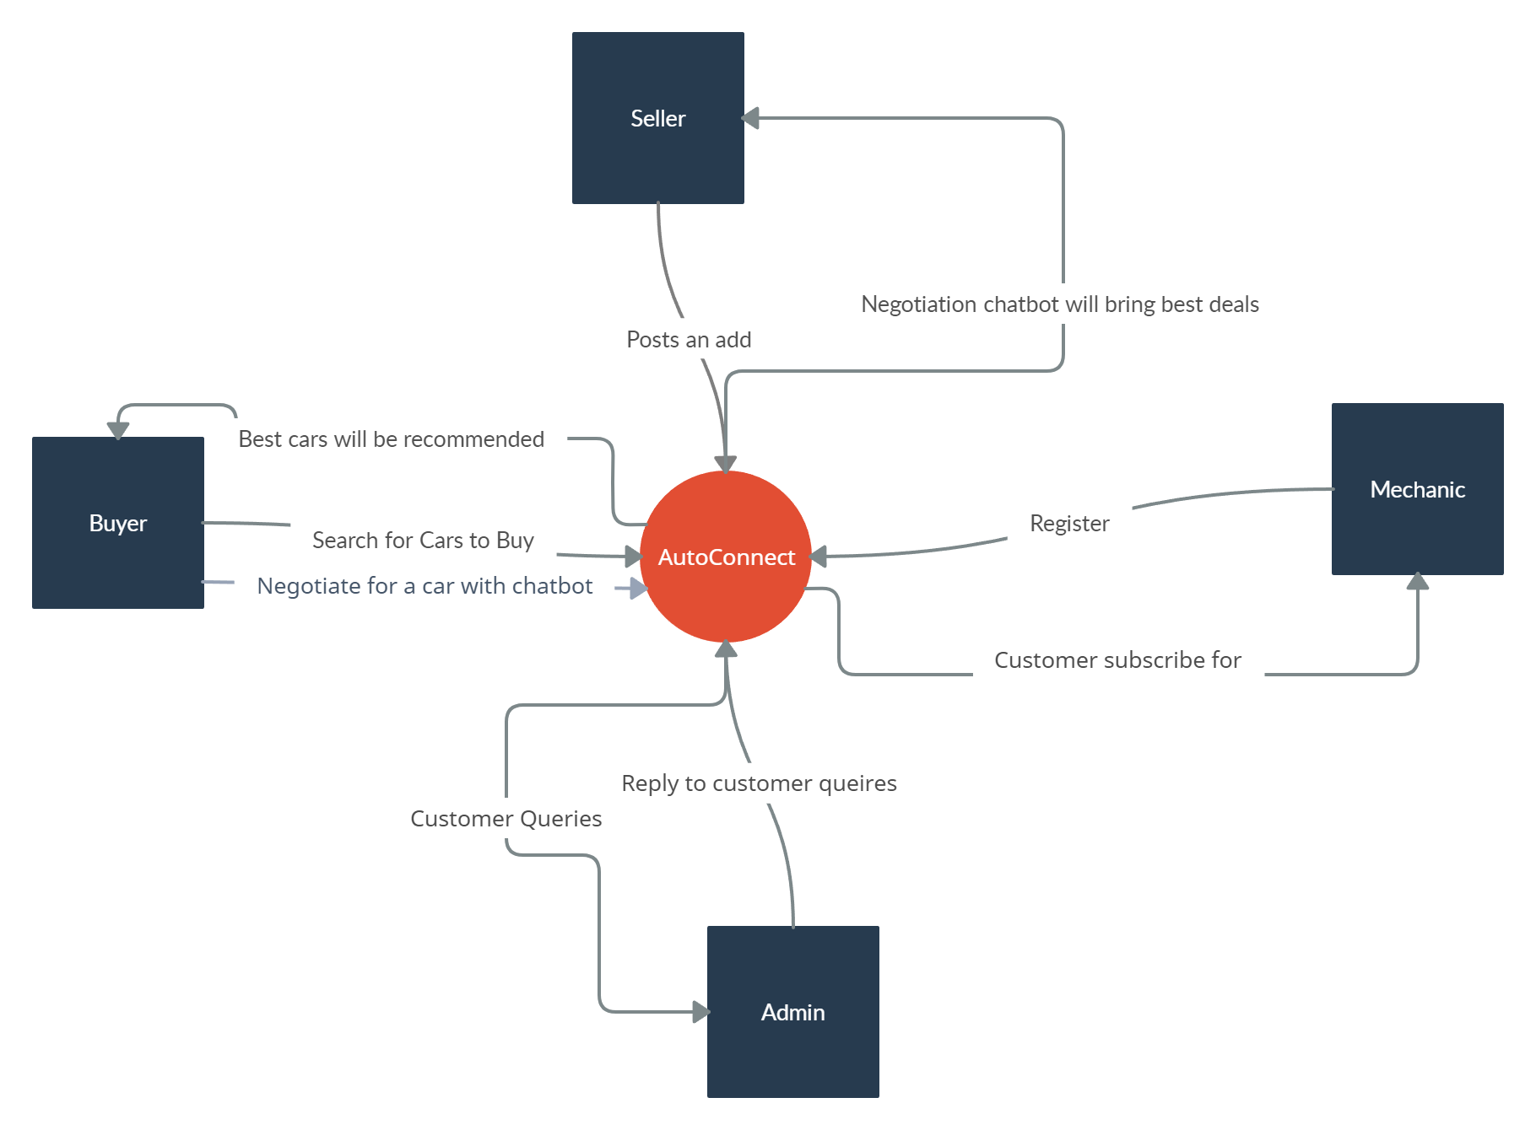
Context Diagram

Slide 11
Waterfall management plan
Requirements
Design
Implementation
Verification
Maintenance

Slide 12
Benefits
1. Streamlined Car Transactions:
"Say goodbye to the hassle! Our app simplifies car buying and selling, making it as easy as a few clicks."
2. Negotiation Assistance:
"Negotiate like a pro! Our chatbot helps you get the best deal, putting you in the driver's seat."
3. Real-Time Video Calls:
"See it, believe it! Conduct video calls with the seller, buyer, and even a mechanic for complete transparency."
4. Tailored Recommendations:
"Find your dream ride! Our AI learns your preferences and recommends cars that match your style."
5. Secure Payments:
"Safe and sound! We integrate top-notch payment gateways to ensure secure transactions."
6. Extensive Search and Filters:
"Your perfect match is waiting! Use powerful search and filtering options to find the ideal vehicle."

Slide 13
7. User Reviews and Ratings:
"Trust the community! Read user reviews and ratings to make informed decisions."
8. Instant Messaging and Notifications:
"Stay connected! Our real-time messaging and notifications keep you updated on your car journey."
9. Mobile Responsiveness:
- "On the move? No problem! Our app adapts seamlessly to your device, giving you the best experience."
10. Outstanding Customer Support:
- "We've got your back! Enjoy excellent customer support with our live chat and assistance tools."
11. Revolutionize Negotiations:
- "Empower yourself! We're changing the game with AI-powered negotiations."
12. Modern, Intuitive UI:
- "Beauty and brains! Our app combines stunning design with effortless usability."

Slide 14
Tech Stack
Front End
Back End
Chat bot
-React
-Redux
-MUI
-React Router
-Node JS
-Express
-MongoDB
-Passport.js
-Elastic Search/Algolia
-Socket.IO
-TensorFlow.js/Brain.js
-NLP
-NLTK/Spacy
-ML
-Tensor Flow/PyTorch
-Dialogue Flow
-Dialogue Flow By Google

Slide 15
Market Survey

Slide 16
Timeline
Elapsed time in months | Milestones
FYP 1
Month 1 - October | - SRS Documentation - SDS Documentation - UI Design
Month 2 - November | - Database Design - UI Implementation - Portal and user account module - Customer support module
Month 3 - December | - Vehicle Comparison and History module - User reviews module
FYP 2
Month 4 - January | Overall Development of Backend. Whole ecommerce platform will be functional by the end of the month beside chatbot and live video calling features.

Slide 17
Month 5 - February | - Chat bot component designing
Month 6 - March | - Chabot training and integration in the web app - Real-time buyer/seller communication module
Month 7 - April | - Integration of Live Video Calling Feature and testing of web app
Month 8 - May | Final report

Slide 18
THANK YOU!

